Slide 1
Recommendation Algorithms
Lecturer: Dr. Bo Yuan
E-mail: yuanb@sz.tsinghua.edu.cn

Slide 2
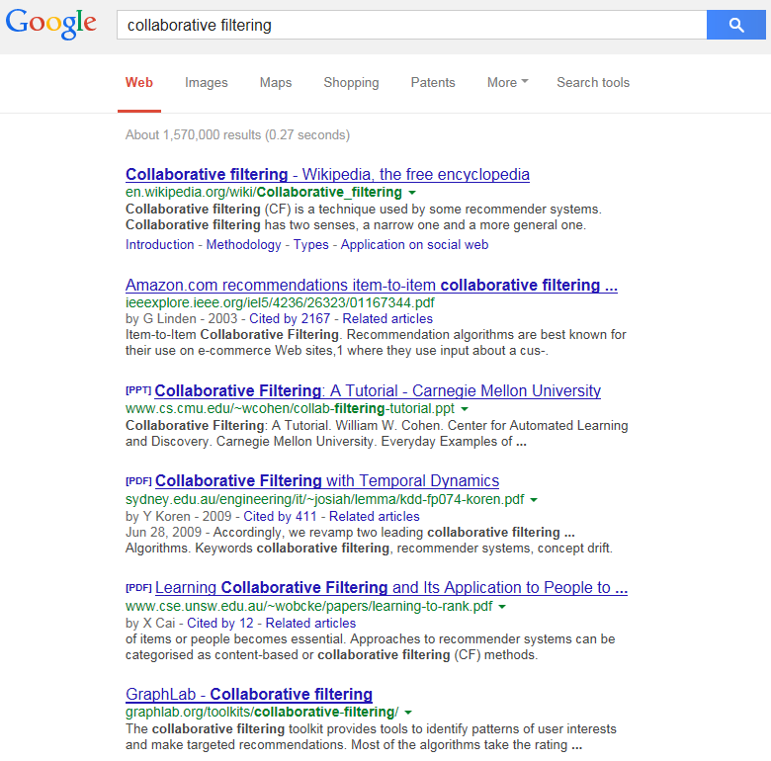
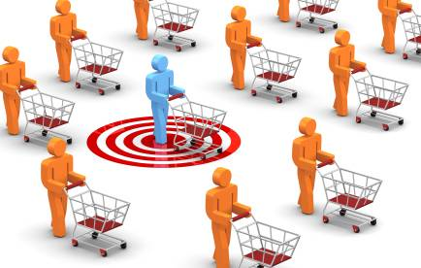
Overview
TF-IDF
Vector Space Model
Latent Semantic Analysis
PageRank
Collaborative Filtering
more relevant
less relevant

Slide 3
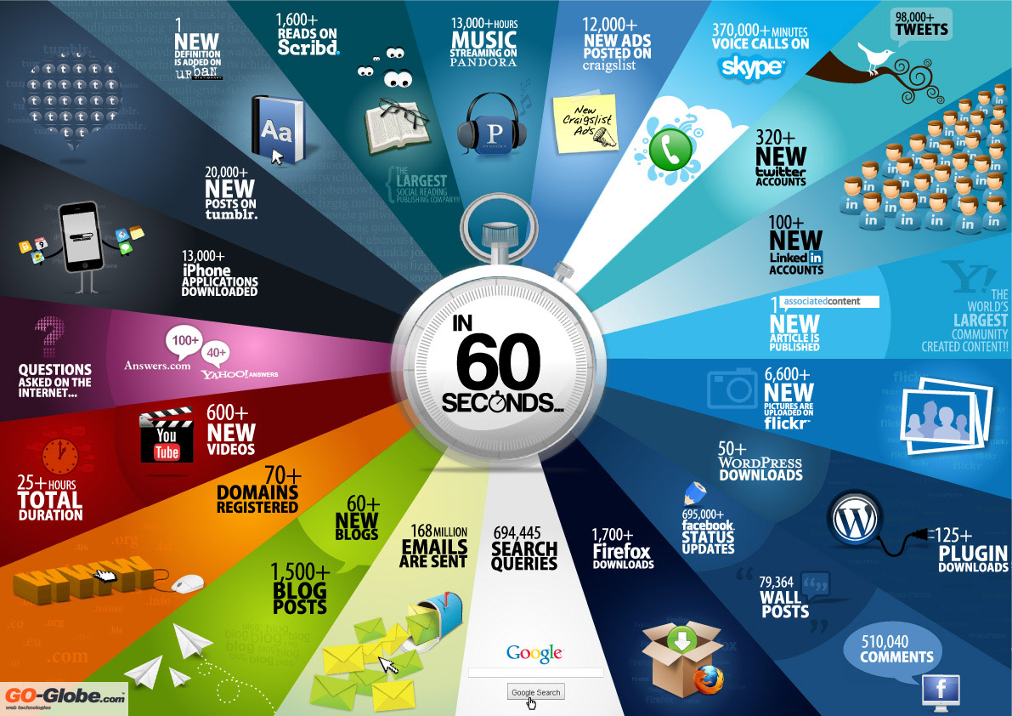

Slide 4
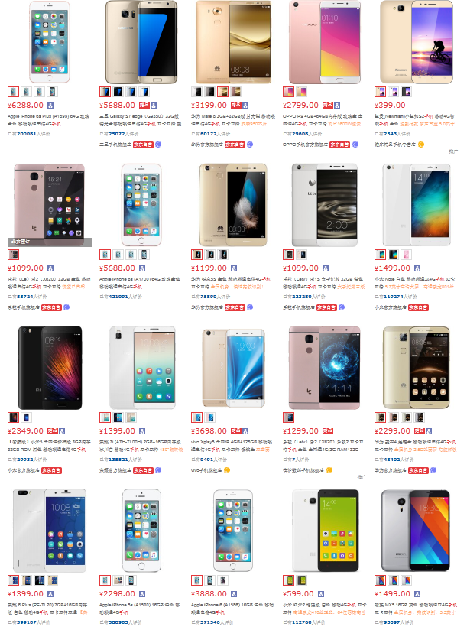
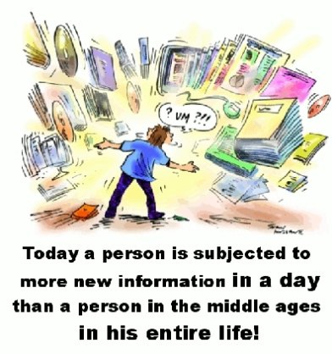
Information Overload

Slide 5



Recommendation Systems
A system that predicts a user’s rating or preference to an item.
  Help people discover interesting or informative stuff that they wouldn't have thought to search for.
  One of the most influential applications of data mining.
Content-Based Filtering
  Focuses on the characteristics of items.
  Recommends items similar to those that a user liked in the past.
Collaborative Filtering
  Predicts what users will like based on their similarity to other users.
  Similar to asking the opinions of friends.
  Does not rely on machine analysable contents.

Slide 6

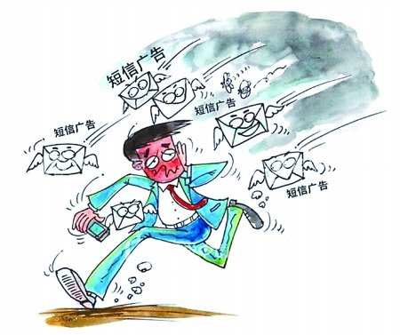
Junk Advertisement
Your Trash Can Be Someone's Treasure!

Slide 7




Targeted Advertisement
Ads Engine
Knowledge Base
What are you browsing?
Who are you?
Previous Record
Where are you?

Slide 8
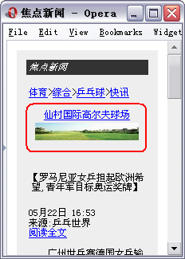
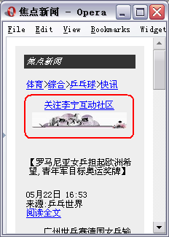
Mobile Advertisement Platform

Slide 9

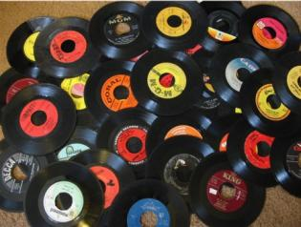
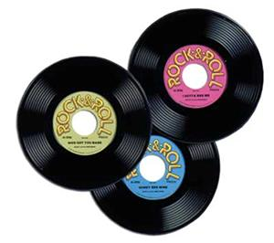

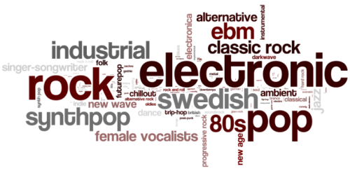
Music Recommendation
Keywords
Preference
Popularity
Ranking
Feedback (rating, like vs. dislike)

Slide 10
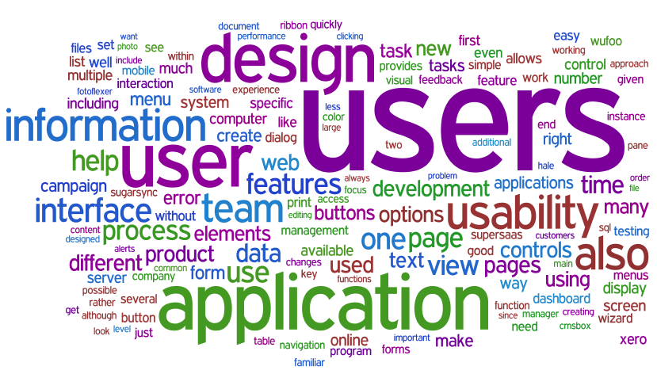
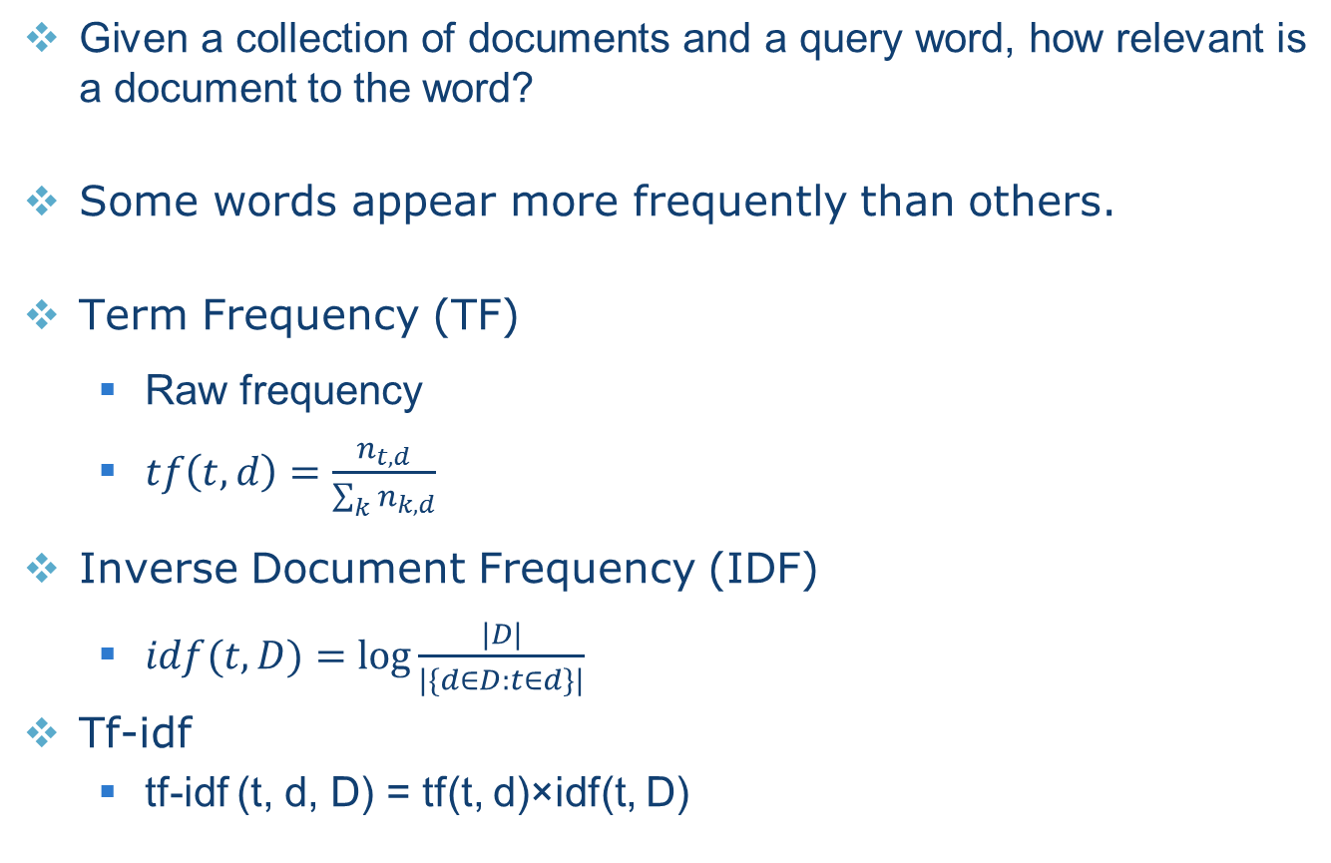
Tf-idf
  Given a collection of documents and a query word, how relevant is a document to the word?
Some words appear more frequently than others.
Term Frequency (TF)
  Raw frequency
  $tf\left(t,d\right)=\frac{n_{t,d}}{\sum_{k}{n_{k,d}}}$
Inverse Document Frequency (IDF)
  $idf(t, D)=\log{\frac{|D|}{|\{d∈D:t∈d\}|}}$
Tf-idf
  tf-idf (t, d, D) = tf(t, d)×idf(t, D)

Slide 11
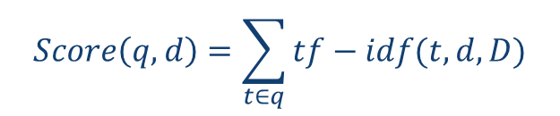
Tf-idf
Multiple query words
$$Score\left(q,d\right)=\sum_{t∈q}{tf−idf(t,d,D)}$$
 | Doc 1 | Doc 2 | Doc 3 | Doc 4
the | 20 | 10 | 15 | 8
best | 0 | 1 | 0 | 2
car | 3 | 5 | 0 | 0
Term-Document Matrix

Slide 12
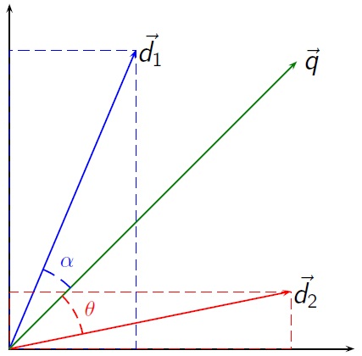
Vector Space Model
An algebraic model for representing text documents as vectors.
Cosine Similarity
tf-idf weighting

Slide 13

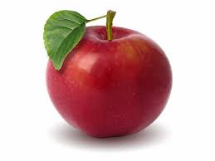
Vector Space Model
Synonymy
  Different words, same meaning
  Car, Vehicle, Automobile
  Small cosine values → unrelated
  Poor recall
Polysemy
  One word, different meanings
  Apple Computer vs. Apple Juice
  Large cosine values → related
  Poor precision
Let’s work in a more informative space.
  Merge dimensions with similar meanings.
  Singular Value Decomposition

Slide 14
Latent Semantic Analysis

Slide 15
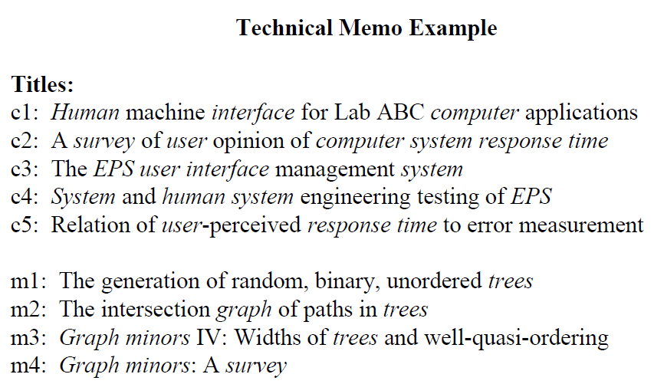
Latent Semantic Analysis

Slide 16
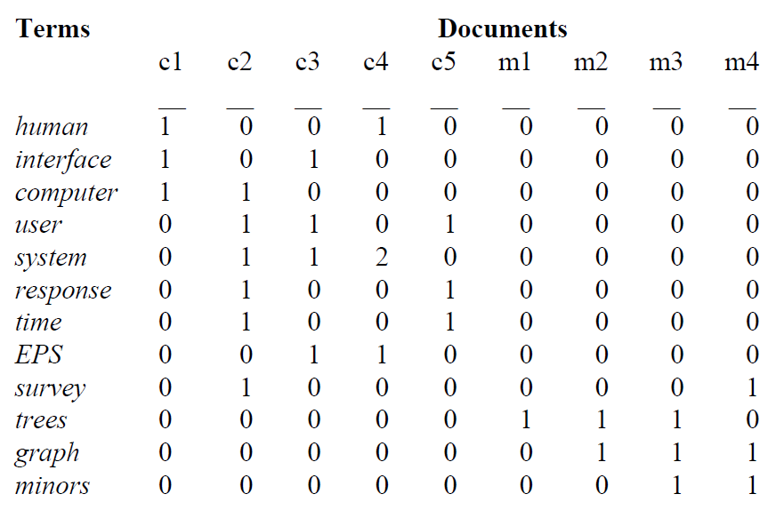
Original Matrix

Slide 17
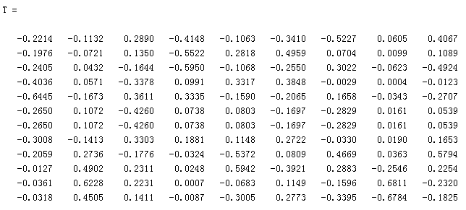
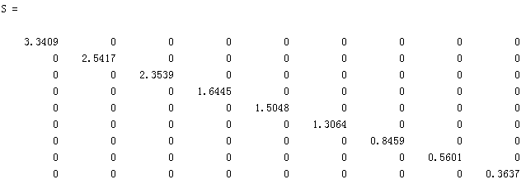
Decomposition

Slide 18
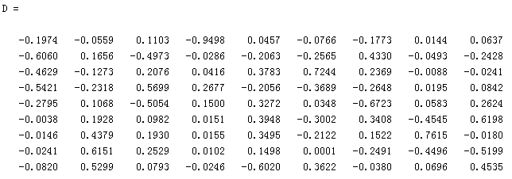
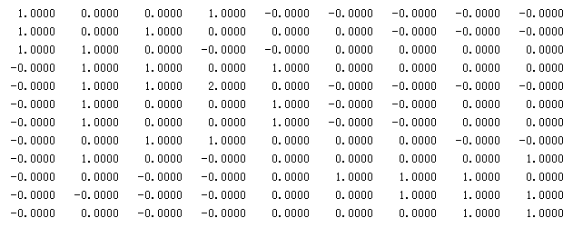
Decomposition

Slide 19


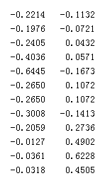

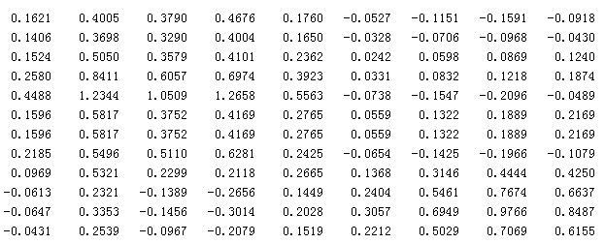
Rank K Approximation
K=2

Slide 20
Items in 2D Space

Slide 21
Documents in 2D Space

Slide 22
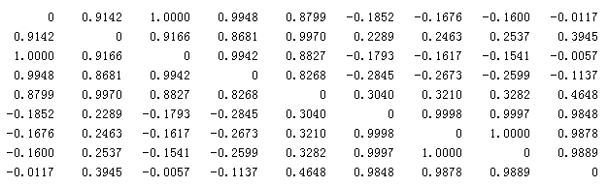
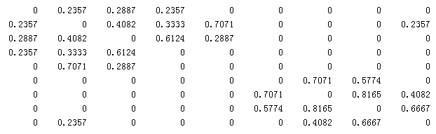
Document Cosine Similarity
Transformed
Original

Slide 23
Query
C
M
Cosine Similarity to Current Documents

Slide 24
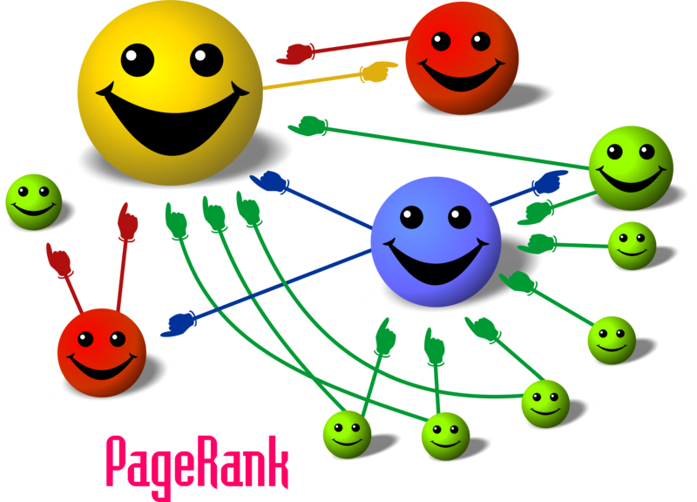
Linked Documents

Slide 25
PageRank
Given a set of hyperlinked documents, how to evaluate the relative importance of each document?
A hyperlink to a page counts as a vote of support.
  The importance of vote from a page depends on its own PageRank and the number of outbound links.
The PageRank of a page is determined by the number and PageRank metric of all pages that link to it.
The outbound links of a page do not affect its PageRank value.
  Difficult to manipulate inbound links.
A key factor determining a page’s ranking in the search results of Google.

Slide 26
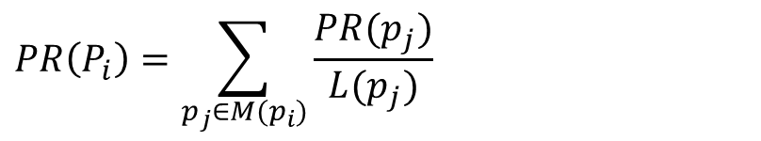
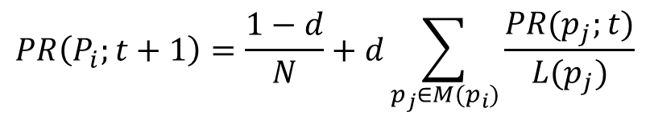
PageRank
A
B
$$PR\left(P_{i}\right)=\sum_{p_{j}∈M(p_{i})}{\frac{PR(p_{j})}{L(p_{j})}}$$
C
D
$$PR\left(P_{i};t+1\right)=\frac{1−d}{N}+d\sum_{p_{j}∈M(p_{i})}{\frac{PR(p_{j};t)}{L(p_{j})}}$$
d: damping factor (0.85)

Slide 27
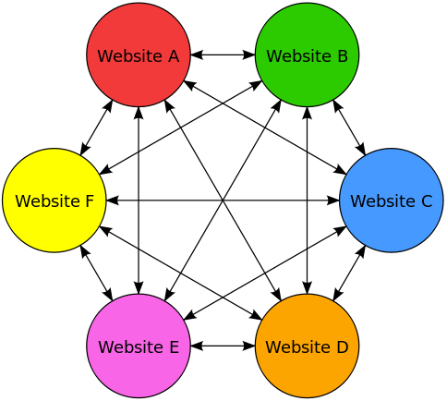
PageRank

Slide 28
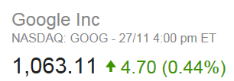
Monetary Success
Stanford University received 1.8 million shares for allowing Google Inc. to use this technique.
  Sergey Brin: US$ 37 billion (2016)
  Larry Page: US$ 38 billion (2016)
Made totally US$ 336 million in return by 2005.
  Within two years after Google’s IPO
  Around US$ 187 per share
  How about if the shares are sold today?
Current Endowment: US$ 22 billion
One of the largest single academic licensing transactions
  Cloning Technology: US$ 225 million in royalties

Slide 29

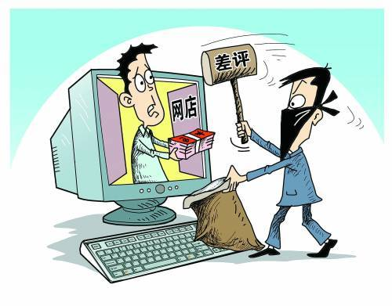
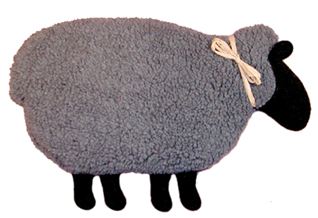

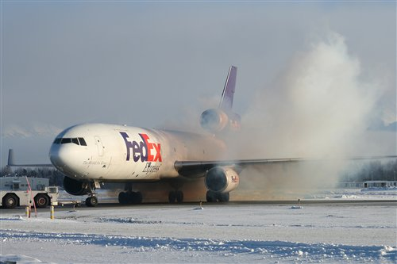
Collaborative Filtering
Core Idea:
  People get the best recommendation from others with similar tastes.
Workflow:
  Creates a rating or purchase matrix.
  Finds similar people by matching their ratings.
  Recommends items that similar people rate highly.
Memory-Based CF
  User-Based vs. Item-Based
Model-Based CF
Things to know:
  Gray Sheep
  Shilling Attack
  Cold Start

Slide 30
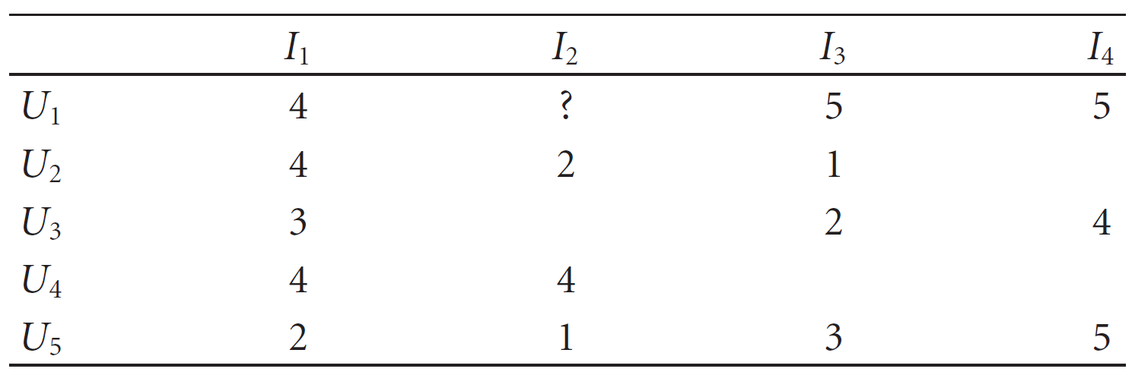
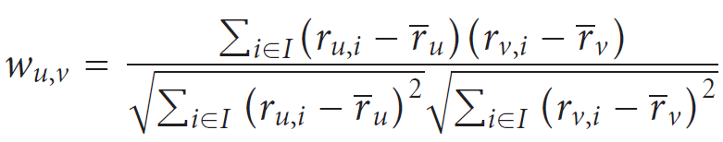
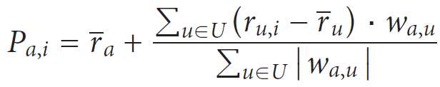
User-Based CF

Slide 31
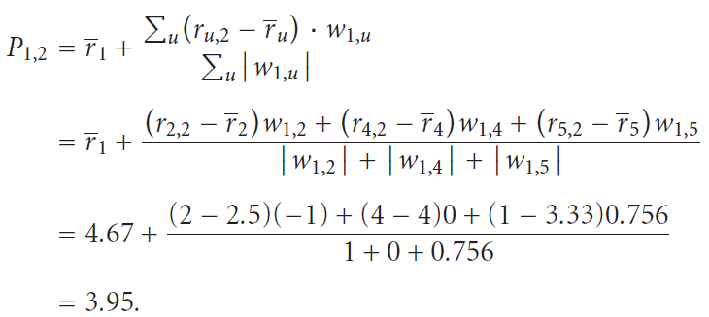
User-Based CF

Slide 32
Item-Based CF
U: Users that have rated both i and j.
I: All items that have been rated by User a.

Slide 33
Item-Based CF
U: Users that have rated i.
U: Users that have rated both i and j.
I: Items that the user has rated and have dev values.

Slide 34
Item-Based CF
Customer | Item 1 | Item 2 | Item 3
John | 5 | 3 | 2
Mark | 3 | 4 | Didn't rate it
Lucy | Didn't rate it | 2 | 5
Slope One

Slide 35
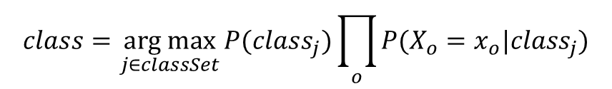
Model-Based CF
Class Label
Attributes
Training Samples
$$class=\underset{j∈classSet}{arg max}{P({class}_{j})\prod_{o}{P(X_{o}=x_{o}|{class}_{j})}}$$

Slide 36

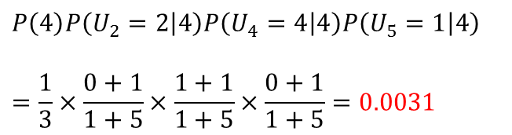
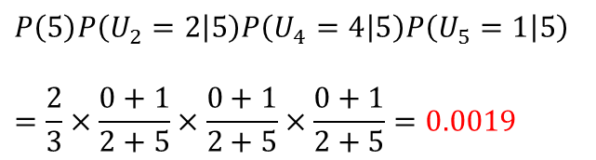
Model-Based CF
$$class=\underset{c_{j}∈\{1,2,3,4,5\}}{arg max}{P\left(c_{j}\right)P\left(U_{2}=2 | c_{j}\right)P\left(U_{4}=4|c_{j}\right)P(U_{5}=1|c_{j})}$$
$$=\underset{c_{j}∈\{1,2,3,4,5\}}{arg max}\left\{0, 0, 0, 0.0031, 0.0019\right\}=4$$
$$P\left(5\right)P\left(U_{2}=2 | 5\right)P\left(U_{4}=4 | 5\right)P\left(U_{5}=1 | 5\right)$$
$$=\frac{2}{3}×\frac{0+1}{2+5}×\frac{0+1}{2+5}×\frac{0+1}{2+5}=0.0019$$
$$P\left(4\right)P\left(U_{2}=2 | 4\right)P\left(U_{4}=4 | 4\right)P\left(U_{5}=1 | 4\right)$$
$$=\frac{1}{3}×\frac{0+1}{1+5}×\frac{1+1}{1+5}×\frac{0+1}{1+5}=0.0031$$

Slide 37
Model-Based CF
 | I₁ | I₂ | I₃ | I₄ | I₅
U₁ | Like | Dislike | Dislike |  | Like
U₂ | Dislike |  |  | Dislike | Dislike
U₃ |  | Like | Like |  | Like
Class Label | Like | Dislike | Like | Like | ?
 | I₁ | I₂ | I₃ | I₄ | I₅
U₁ like | 1 | 0 | 0 | 0 | 1
U₁ dislike | 0 | 1 | 1 | 0 | 0
U₂ like | 0 | 0 | 0 | 0 | 0
U₂ dislike | 1 | 0 | 0 | 1 | 1
U₃ like | 0 | 1 | 1 | 0 | 1
U₃ dislike | 0 | 0 | 0 | 0 | 0
Class Label | Like | Dislike | Like | Like | ?

Slide 38

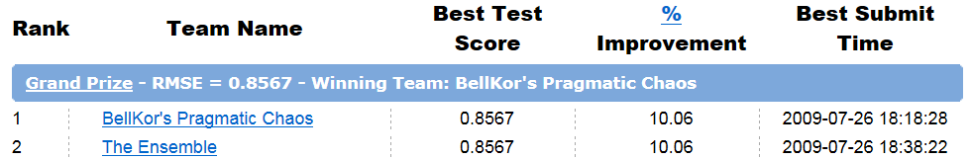
Netflix Prize
A public company providing DVD-rental service
Target:
  To predict whether someone will enjoy a movie based on how much they liked or disliked other movies.
  To improve the score of its own Cinematch by 10%
  RMSE (Root Mean Squared Error)
Training Set:
  <user, movie, date of grade, grade>
  480,189 users, 17,770 movies,100,480,507 ratings

Slide 39


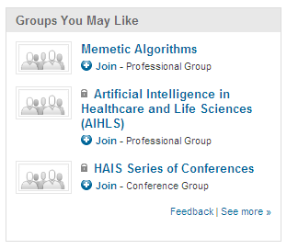
KDD Cup

Slide 40
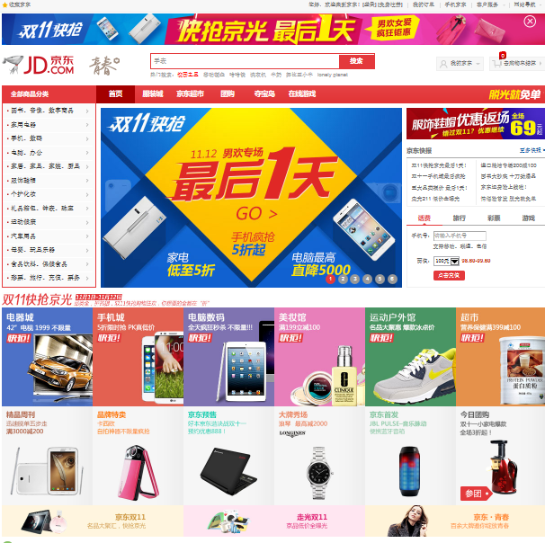
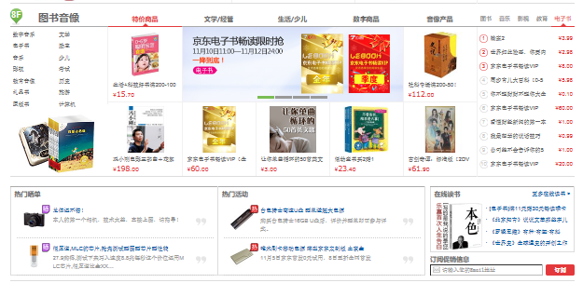
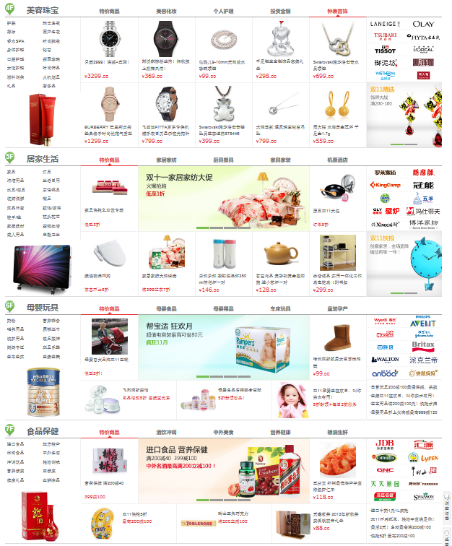
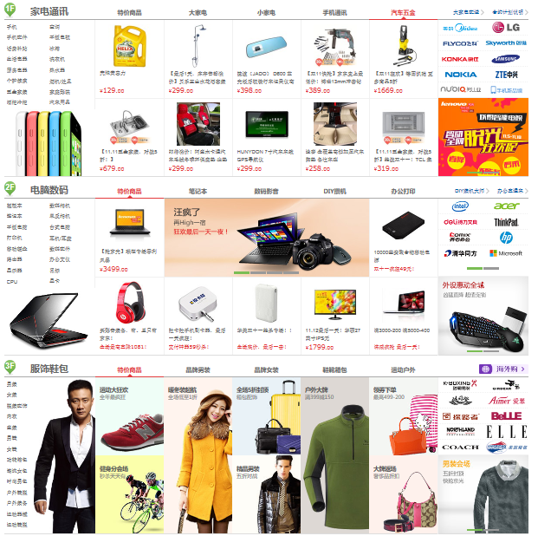

Slide 41




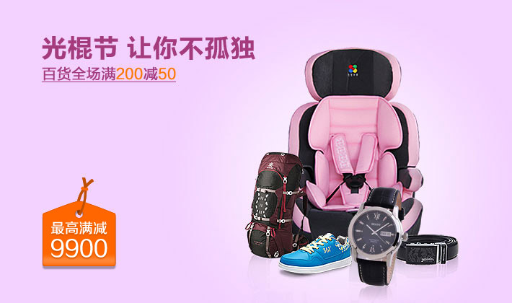


Slide 42


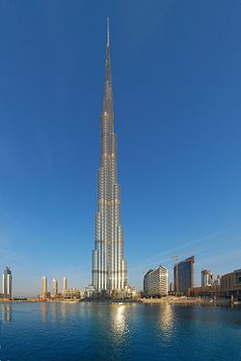


Slide 43
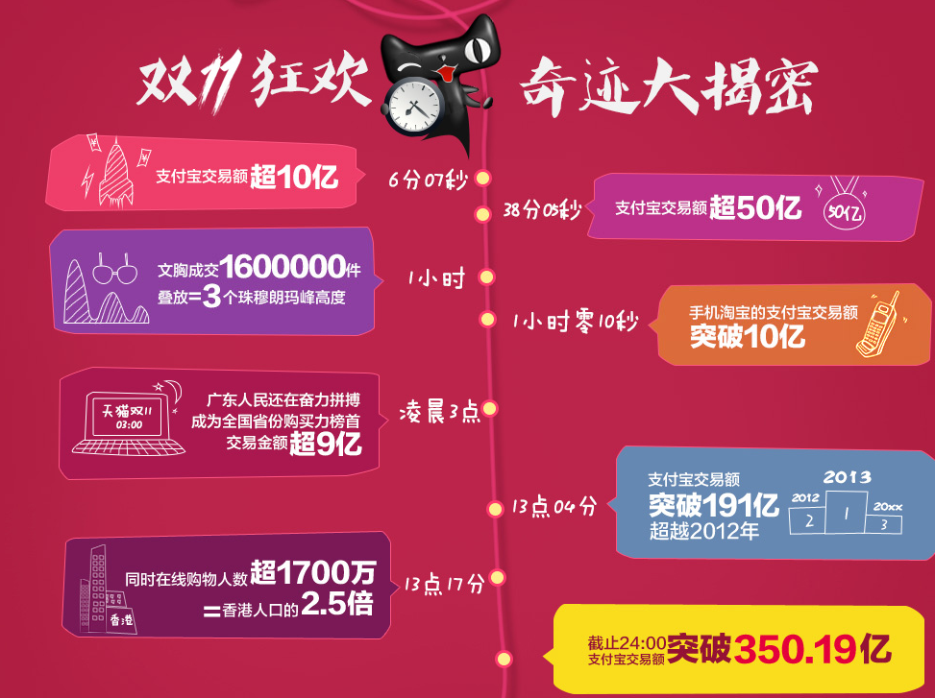

Slide 44




Reality Mining

Slide 45



Reality Mining

Slide 46








Slide 47


Open Questions
Customers are analyzed based solely on purchasing records.
  More dimensions are to be added.
  Just image how to recommend something to your friend …
People have different personalities.
  Different strategies may be required.
  Selling insurance: Emotional vs. Mature
People buy things for different reasons.
  Impulse Buying vs. Planned Buying
  Time Variant

Slide 48
Reading Materials
P. Resnick, N. Iacovou, M. Suchak, P. Bergstrom, and J. Riedl, “Grouplens: an Open Architecture for Collaborative Filtering of Netnews”, in Proceedings of the ACM Conference on Computer Supported Cooperative Work, pp. 175–186, 1994.
D. Billsus and M. Pazzani, “Learning Collaborative Information Filters”, in Proceedings of the 15th International Conference on Machine Learning, pp. 46-54, 1998.
B. Sarwar, G. Karypis, J. Konstan, and J. Riedl, “Item-Based Collaborative Filtering Recommendation Algorithms”, in Proceedings of the 10th international Conference on World Wide Web, pp. 285-295, 2001.
X. Su and T. Khoshgoftaar, “A Survey of Collaborative Filtering Techniques”, Advances in Artificial Intelligence, Article ID: 421425, 2009.
L. Page, S. Brin, R. Motwani, and T. Winograd, “The PageRank Citation Ranking: Bringing Order to the Web”, Technical Report, Stanford InfoLab, 1999.
S. Deerwester, S. Dumais, G. Furnas, T. Landauer, and R. Harshman, “Indexing by Latent Semantic Analysis”, JASIS, vol. 41(6), pp. 391-407, 1990.
E. Nathan and A. Pentland, “Reality Mining: Sensing Complex Social Systems”, Personal and Ubiquitous Computing, vol. 10(4), pp. 255-268, 2006.

Slide 49

Review
Why do we need recommendation algorithms?
What does tf-idf stand for?
What is the definition of cosine similarity?
What are the practical issues of the vector space model?
What is the main procedure of Latent Semantic Analysis?
How is PageRank calculated?
What are the two groups of recommendation algorithms?
What is the core idea behind collaborative filtering?
What are the limitations of collaborative filtering?

